Slide 1
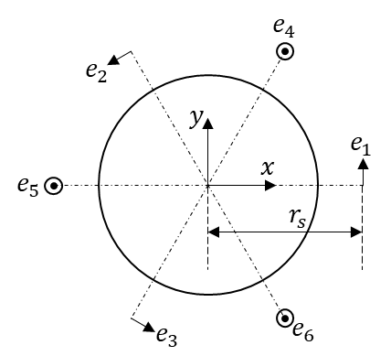
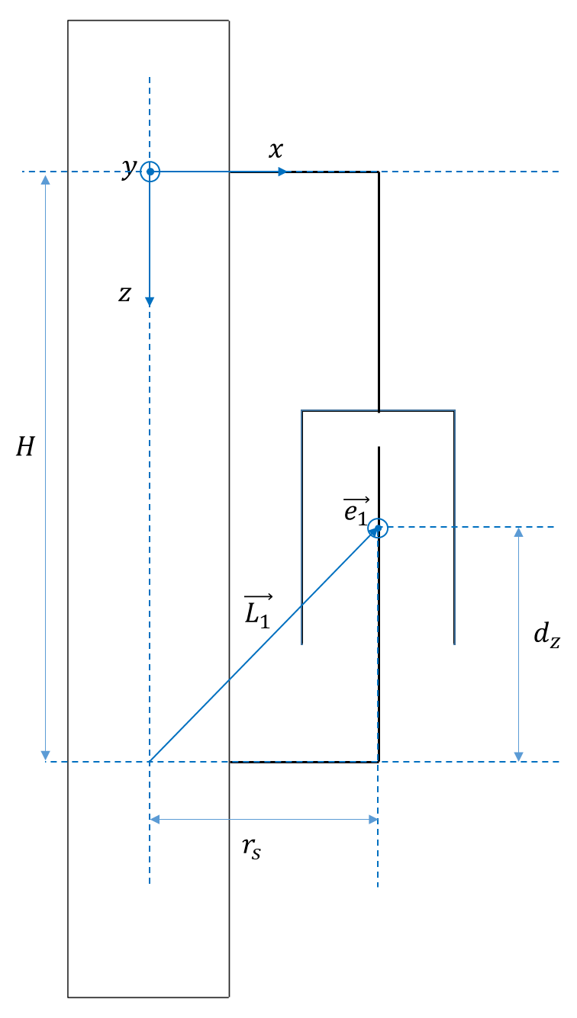
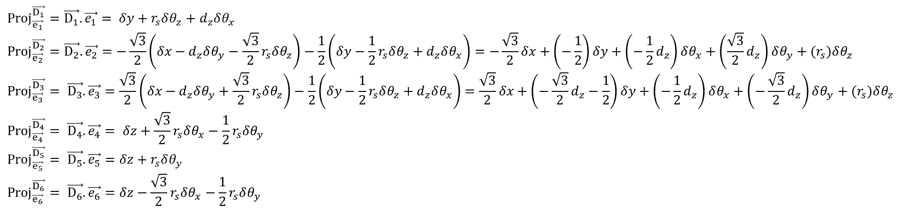
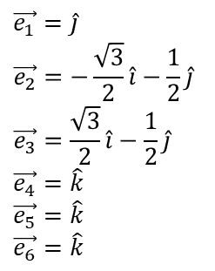
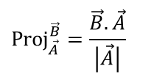
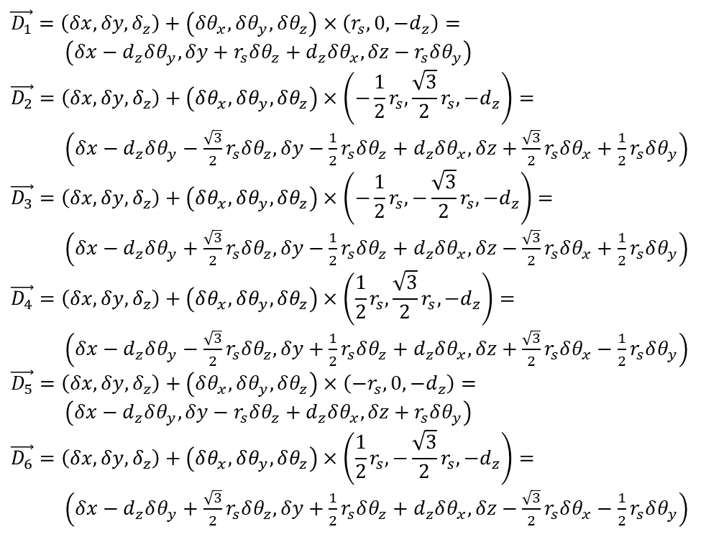
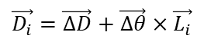
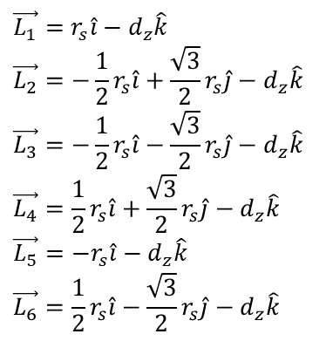
$$\vec{D_{i}}=\vec{ΔD}+\vec{Δθ}×\vec{L_{i}}$$
$$\vec{D_{1}}=\left(δx,δy,δ_{z}\right)+\left(δθ_{x},δθ_{y},δθ_{z}\right)×\left(r_{s},0,−d_{z}\right)=$$ $\left(δx−d_{z}δθ_{y},δy+r_{s}δθ_{z}+d_{z}δθ_{x}, δz−r_{s}δθ_{y}\right)$
$$\vec{D_{2}}=\left(δx,δy,δ_{z}\right)+\left(δθ_{x},δθ_{y},δθ_{z}\right)×\left(−\frac{1}{2}r_{s},\frac{\sqrt{3}}{2}r_{s},−d_{z}\right)=$$ $\left(δx−d_{z}δθ_{y}−\frac{\sqrt{3}}{2}r_{s}δθ_{z},δy−\frac{1}{2}r_{s}δθ_{z}+d_{z}δθ_{x}, δz+\frac{\sqrt{3}}{2}r_{s}δθ_{x}+\frac{1}{2}r_{s}δθ_{y}\right)$
$$\vec{D_{3}}=\left(δx,δy,δ_{z}\right)+\left(δθ_{x},δθ_{y},δθ_{z}\right)×\left(−\frac{1}{2}r_{s},−\frac{\sqrt{3}}{2}r_{s},−d_{z}\right)=$$ $\left(δx−d_{z}δθ_{y}+\frac{\sqrt{3}}{2}r_{s}δθ_{z},δy−\frac{1}{2}r_{s}δθ_{z}+d_{z}δθ_{x}, δz−\frac{\sqrt{3}}{2}r_{s}δθ_{x}+\frac{1}{2}r_{s}δθ_{y}\right)$
$$\vec{D_{4}}=\left(δx,δy,δ_{z}\right)+\left(δθ_{x},δθ_{y},δθ_{z}\right)×\left(\frac{1}{2}r_{s},\frac{\sqrt{3}}{2}r_{s},−d_{z}\right)=$$ $\left(δx−d_{z}δθ_{y}−\frac{\sqrt{3}}{2}r_{s}δθ_{z},δy+\frac{1}{2}r_{s}δθ_{z}+d_{z}δθ_{x}, δz+\frac{\sqrt{3}}{2}r_{s}δθ_{x}−\frac{1}{2}r_{s}δθ_{y}\right)$
$$\vec{D_{5}}=\left(δx,δy,δ_{z}\right)+\left(δθ_{x},δθ_{y},δθ_{z}\right)×\left(−r_{s},0,−d_{z}\right)=$$ $\left(δx−d_{z}δθ_{y},δy−r_{s}δθ_{z}+d_{z}δθ_{x}, δz+r_{s}δθ_{y}\right)$
$$\vec{D_{6}}=\left(δx,δy,δ_{z}\right)+\left(δθ_{x},δθ_{y},δθ_{z}\right)×\left(\frac{1}{2}r_{s},−\frac{\sqrt{3}}{2}r_{s},−d_{z}\right)=$$ $\left(δx−d_{z}δθ_{y}+\frac{\sqrt{3}}{2}r_{s}δθ_{z},δy+\frac{1}{2}r_{s}δθ_{z}+d_{z}δθ_{x}, δz−\frac{\sqrt{3}}{2}r_{s}δθ_{x}−\frac{1}{2}r_{s}δθ_{y}\right)$
$$\vec{e_{1}}=\hat{j}$$
$$\vec{e_{2}}=−\frac{\sqrt{3}}{2}\hat{i}−\frac{1}{2}\hat{j}$$
$$\vec{e_{3}}=\frac{\sqrt{3}}{2}\hat{i}−\frac{1}{2}\hat{j}$$
$$\vec{e_{4}}=\hat{k}$$
$$\vec{e_{5}}=\hat{k}$$
$$\vec{e_{6}}=\hat{k}$$
$$\vec{L_{1}}=r_{s}\hat{i}−d_{z}\hat{k}$$
$$\vec{L_{2}}=−\frac{1}{2}r_{s}\hat{i}+\frac{\sqrt{3}}{2}r_{s}\hat{j}−d_{z}\hat{k}$$
$$\vec{L_{3}}=−\frac{1}{2}r_{s}\hat{i}−\frac{\sqrt{3}}{2}r_{s}\hat{j}−d_{z}\hat{k}$$
$$\vec{L_{4}}=\frac{1}{2}r_{s}\hat{i}+\frac{\sqrt{3}}{2}r_{s}\hat{j}−d_{z}\hat{k}$$
$$\vec{L_{5}}=−r_{s}\hat{i}−d_{z}\hat{k}$$
$$\vec{L_{6}}=\frac{1}{2}r_{s}\hat{i}−\frac{\sqrt{3}}{2}r_{s}\hat{j}−d_{z}\hat{k}$$
$${Proj}_{\vec{A}}^{\vec{B}}=\frac{\vec{B}.\vec{A}}{\left|\vec{A}\right|}$$
$${Proj}_{\vec{e_{1}}}^{\vec{D_{1}}}=\vec{D_{1}}.\vec{e_{1}}= δy+r_{s}δθ_{z}+d_{z}δθ_{x}$$
$${Proj}_{\vec{e_{2}}}^{\vec{D_{2}}}=\vec{D_{2}}.\vec{e_{2}}=−\frac{\sqrt{3}}{2}\left(δx−d_{z}δθ_{y}−\frac{\sqrt{3}}{2}r_{s}δθ_{z}\right)−\frac{1}{2}\left(δy−\frac{1}{2}r_{s}δθ_{z}+d_{z}δθ_{x}\right)=−\frac{\sqrt{3}}{2}δx+\left(−\frac{1}{2}\right)δy+\left(−\frac{1}{2}d_{z}\right)δθ_{x}+\left(\frac{\sqrt{3}}{2}d_{z}\right)δθ_{y}+(r_{s})δθ_{z}$$
$${Proj}_{\vec{e_{3}}}^{\vec{D_{3}}}= \vec{D_{3}}.\vec{e_{3}}=\frac{\sqrt{3}}{2}\left(δx−d_{z}δθ_{y}+\frac{\sqrt{3}}{2}r_{s}δθ_{z}\right)−\frac{1}{2}\left(δy−\frac{1}{2}r_{s}δθ_{z}+d_{z}δθ_{x}\right)=\frac{\sqrt{3}}{2}δx+\left(−\frac{\sqrt{3}}{2}d_{z}−\frac{1}{2}\right)δy+\left(−\frac{1}{2}d_{z}\right)δθ_{x}+\left(−\frac{\sqrt{3}}{2}d_{z}\right)δθ_{y}+(r_{s})δθ_{z}$$
$${Proj}_{\vec{e_{4}}}^{\vec{D_{4}}}= \vec{D_{4}}.\vec{e_{4}}= δz+\frac{\sqrt{3}}{2}r_{s}δθ_{x}−\frac{1}{2}r_{s}δθ_{y}$$
$${Proj}_{\vec{e_{5}}}^{\vec{D_{5}}}= \vec{D_{5}}.\vec{e_{5}}=δz+r_{s}δθ_{y}$$
$${Proj}_{\vec{e_{6}}}^{\vec{D_{6}}}= \vec{D_{6}}.\vec{e_{6}}=δz−\frac{\sqrt{3}}{2}r_{s}δθ_{x}−\frac{1}{2}r_{s}δθ_{y}$$

Slide 2
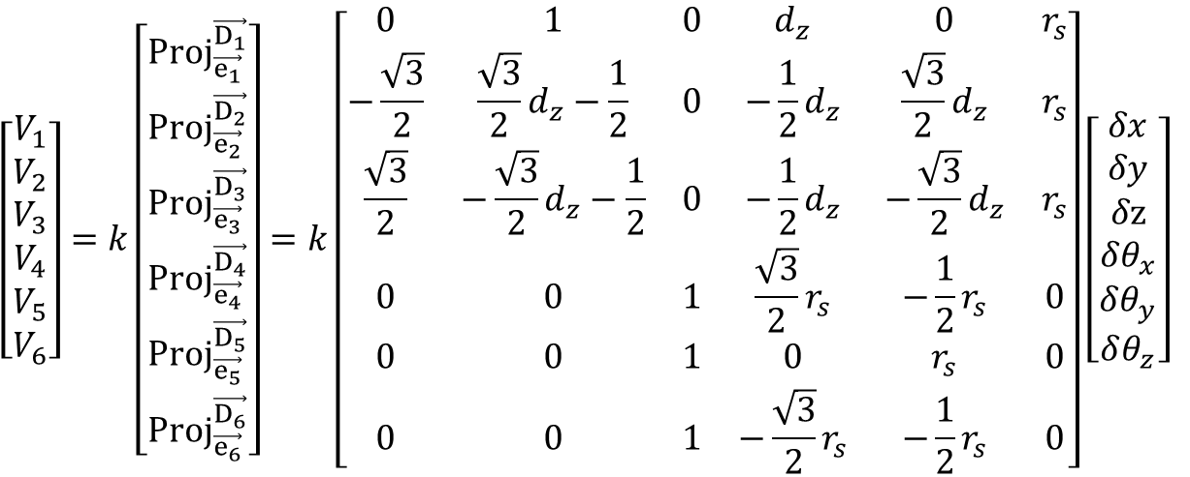
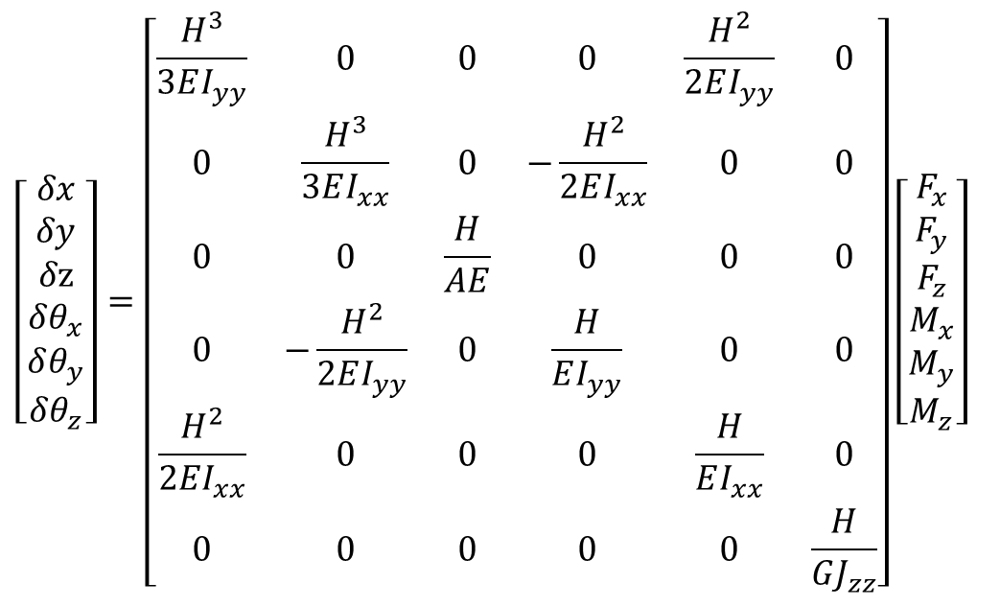
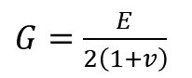
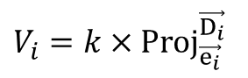
$$V_{i}=k×{Proj}_{\vec{e_{i}}}^{\vec{D_{i}}}$$
$G=\frac{E}{2\left(1+v\right)}$
$$\left[\begin{aligned}V_{1} \\ V_{2} \\ V_{3} \\ V_{4} \\ V_{5} \\ V_{6}\end{aligned}\right]=k\left[\begin{aligned}{Proj}_{\vec{e_{1}}}^{\vec{D_{1}}} \\ {Proj}_{\vec{e_{2}}}^{\vec{D_{2}}} \\ {Proj}_{\vec{e_{3}}}^{\vec{D_{3}}} \\ {Proj}_{\vec{e_{4}}}^{\vec{D_{4}}} \\ {Proj}_{\vec{e_{5}}}^{\vec{D_{5}}} \\ {Proj}_{\vec{e_{6}}}^{\vec{D_{6}}}\end{aligned}\right]=k\left[\begin{matrix}0 & 1 & 0 & d_{z} & 0 & r_{s} \\ −\frac{\sqrt{3}}{2} & \frac{\sqrt{3}}{2}d_{z}−\frac{1}{2} & 0 & −\frac{1}{2}d_{z} & \frac{\sqrt{3}}{2}d_{z} & r_{s} \\ \frac{\sqrt{3}}{2} & −\frac{\sqrt{3}}{2}d_{z}−\frac{1}{2} & 0 & −\frac{1}{2}d_{z} & −\frac{\sqrt{3}}{2}d_{z} & r_{s} \\ 0 & 0 & 1 & \frac{\sqrt{3}}{2}r_{s} & −\frac{1}{2}r_{s} & 0 \\ 0 & 0 & 1 & 0 & r_{s} & 0 \\ 0 & 0 & 1 & −\frac{\sqrt{3}}{2}r_{s} & −\frac{1}{2}r_{s} & 0\end{matrix}\right]\left[\begin{matrix}\begin{aligned}δx \\ δy \\ δz \\ δθ_{x}\end{aligned} \\ δθ_{y} \\ δθ_{z}\end{matrix}\right]$$
$$\left[\begin{matrix}\begin{aligned}δx \\ δy \\ δz \\ δθ_{x}\end{aligned} \\ δθ_{y} \\ δθ_{z}\end{matrix}\right]=\left[\begin{matrix}\frac{H^{3}}{3EI_{yy}} & 0 & 0 & 0 & \frac{H^{2}}{2EI_{yy}} & 0 \\ 0 & \frac{H^{3}}{3EI_{xx}} & 0 & −\frac{H^{2}}{2EI_{xx}} & 0 & 0 \\ 0 & 0 & \frac{H}{AE} & 0 & 0 & 0 \\ 0 & −\frac{H^{2}}{2EI_{yy}} & 0 & \frac{H}{EI_{yy}} & 0 & 0 \\ \frac{H^{2}}{2EI_{xx}} & 0 & 0 & 0 & \frac{H}{EI_{xx}} & 0 \\ 0 & 0 & 0 & 0 & 0 & \frac{H}{GJ_{zz}}\end{matrix}\right]\left[\begin{aligned}F_{x} \\ F_{y} \\ F_{z} \\ M_{x} \\ M_{y} \\ M_{z}\end{aligned}\right]$$

Slide 3
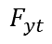
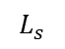
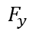
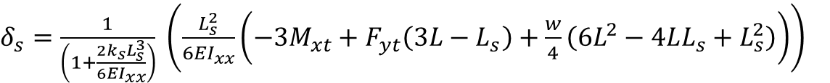
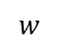
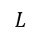
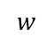
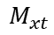
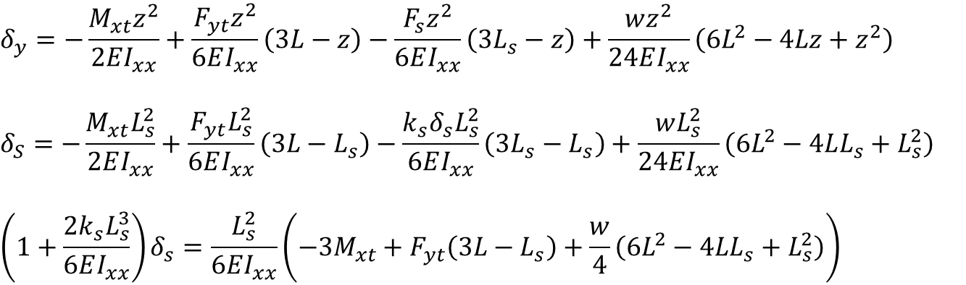
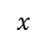
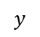
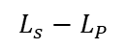
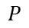
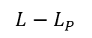
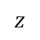
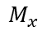
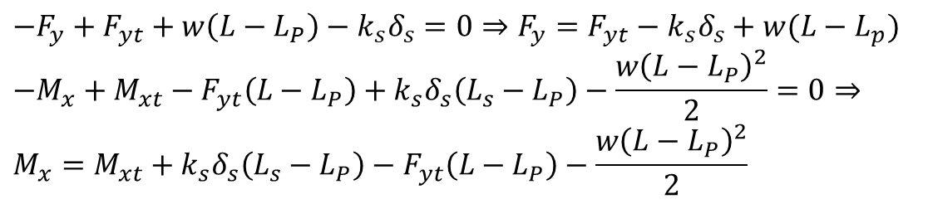
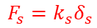
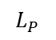
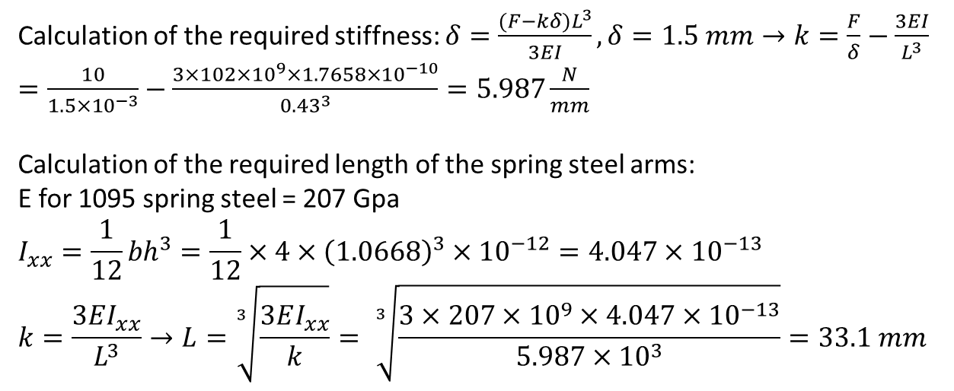
$$y$$
Calculation of the required stiffness: $δ=\frac{(F−kδ)L^{3}}{3EI}, δ=1.5 mm→k=\frac{F}{δ}−\frac{3EI}{L^{3}}=\frac{10}{1.5×{10}^{−3}}−\frac{3×102×{10}^{9}×1.7658×{10}^{−10}}{{0.43}^{3}}=5.987\frac{N}{mm}$
Calculation of the required length of the spring steel arms:
E for 1095 spring steel = 207 Gpa
$$I_{xx}=\frac{1}{12}{bh}^{3}=\frac{1}{12}×4×{\left(1.0668\right)}^{3}×{10}^{−12}=4.047×{10}^{−13}$$
$$k=\frac{3EI_{xx}}{L^{3}}→L=\sqrt[3]{\frac{3EI_{xx}}{k}}= \sqrt[3]{\frac{3×207×{10}^{9}×4.047×{10}^{−13}}{5.987×{10}^{3}}}=33.1 mm$$
$$x$$
$$z$$
$$F_{s}=k_{s}δ_{s}$$
$$L_{P}$$
$$P$$
$$s$$
$$M_{xt}$$
$$w$$
$$F_{yt}$$
$$L_{s}$$
$$L$$
$$F_{y}$$
$$F_{s}=k_{s}δ_{s}$$
$$M_{x}$$
$$P$$
$$s$$
$$M_{xt}$$
$$δ_{y}=−\frac{M_{xt}z^{2}}{2EI_{xx}}+\frac{F_{yt}z^{2}}{6EI_{xx}}\left(3L−z\right)−\frac{F_{s}z^{2}}{6EI_{xx}}\left(3L_{s}−z\right)+\frac{wz^{2}}{24EI_{xx}}\left(6L^{2}−4Lz+z^{2}\right)$$
$$δ_{S}=−\frac{M_{xt}L_{s}^{2}}{2EI_{xx}}+\frac{F_{yt}L_{s}^{2}}{6EI_{xx}}\left(3L−L_{s}\right)−\frac{k_{s}δ_{s}L_{s}^{2}}{6EI_{xx}}\left(3L_{s}−L_{s}\right)+\frac{wL_{s}^{2}}{24EI_{xx}}\left(6L^{2}−4LL_{s}+L_{s}^{2}\right)$$
$$\left(1+\frac{2k_{s}L_{s}^{3}}{6EI_{xx}}\right)δ_{s}=\frac{L_{s}^{2}}{6EI_{xx}}\left(−3M_{xt}+F_{yt}\left(3L−L_{s}\right)+\frac{w}{4}\left(6L^{2}−4LL_{s}+L_{s}^{2}\right)\right)$$
$$w$$
$$F_{yt}$$
$$L_{s}−L_{P}$$
$$L−L_{P}$$
$δ_{s}=\frac{1}{\left(1+\frac{2k_{s}L_{s}^{3}}{6EI_{xx}}\right)} \left(\frac{L_{s}^{2}}{6EI_{xx}}\left(−3M_{xt}+F_{yt}\left(3L−L_{s}\right)+\frac{w}{4}\left(6L^{2}−4LL_{s}+L_{s}^{2}\right)\right)\right)$
$$−F_{y}+F_{yt}+w\left(L−L_{P}\right)−k_{s}δ_{s}=0⇒F_{y}={F_{yt}−k}_{s}δ_{s}+w(L−L_{p})$$
$$−M_{x}+M_{xt}−F_{yt}\left(L−L_{P}\right)+k_{s}δ_{s}\left(L_{s}−L_{P}\right)−\frac{w{\left(L−L_{P}\right)}^{2}}{2}=0⇒ \\ M_{x}=M_{xt}+k_{s}δ_{s}\left(L_{s}−L_{P}\right)−F_{yt}\left(L−L_{P}\right)−\frac{w{\left(L−L_{P}\right)}^{2}}{2}$$

Slide 4
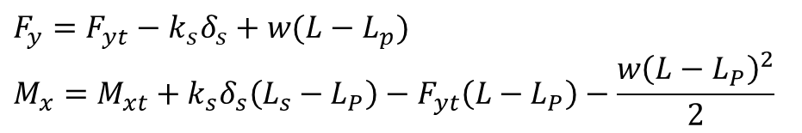
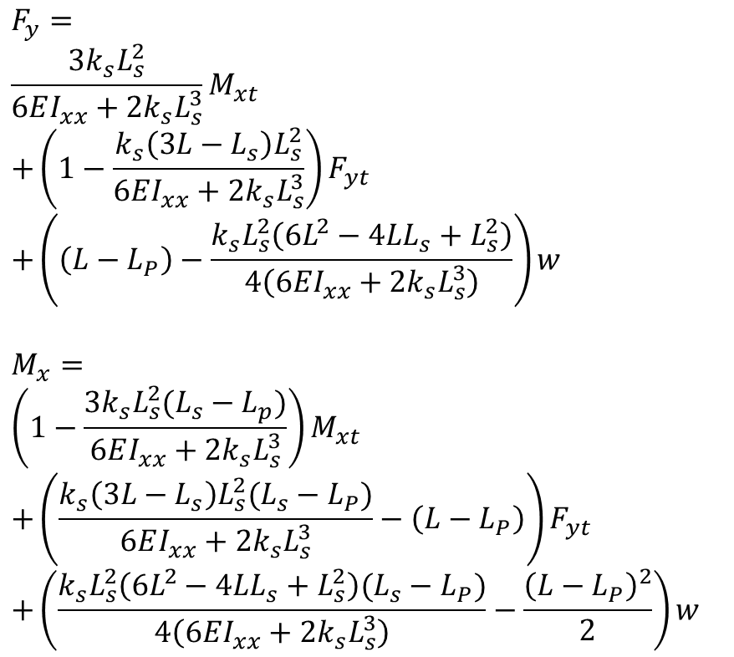
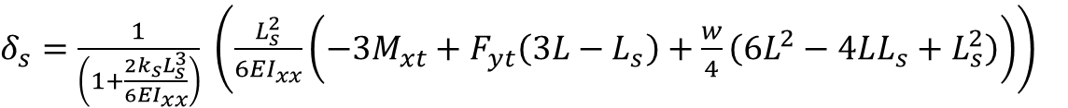
$$y$$
$$x$$
$$z$$
$$F_{s}=k_{s}δ_{s}$$
$δ_{s}=\frac{1}{\left(1+\frac{2k_{s}L_{s}^{3}}{6EI_{xx}}\right)} \left(\frac{L_{s}^{2}}{6EI_{xx}}\left(−3M_{xt}+F_{yt}\left(3L−L_{s}\right)+\frac{w}{4}\left(6L^{2}−4LL_{s}+L_{s}^{2}\right)\right)\right)$
$$L_{P}$$
$$P$$
$$s$$
$$M_{xt}$$
$$w$$
$$F_{yt}$$
$$F_{y}={F_{yt}−k}_{s}δ_{s}+w(L−L_{p})$$
$$M_{x}=M_{xt}+k_{s}δ_{s}\left(L_{s}−L_{P}\right)−F_{yt}\left(L−L_{P}\right)−\frac{w{\left(L−L_{P}\right)}^{2}}{2}$$
$$L_{s}$$
$$L$$
$$F_{y}$$
$$F_{s}=k_{s}δ_{s}$$
$$M_{x}$$
$$P$$
$$s$$
$$M_{xt}$$
$$F_{y}= \\ \frac{3k_{s}L_{s}^{2}}{6EI_{xx}+2k_{s}L_{s}^{3}}M_{xt} \\ +\left(1−\frac{k_{s}\left(3L−L_{s}\right)L_{s}^{2}}{6EI_{xx}+2k_{s}L_{s}^{3}}\right)F_{yt} \\ +\left(\left(L−L_{P}\right)−\frac{k_{s}L_{s}^{2}\left(6L^{2}−4LL_{s}+L_{s}^{2}\right)}{4\left(6EI_{xx}+2k_{s}L_{s}^{3}\right)}\right)w$$
$$M_{x}= \\ \left(1−\frac{3k_{s}L_{s}^{2}(L_{s}−L_{p})}{6EI_{xx}+2k_{s}L_{s}^{3}}\right)M_{xt} \\ +\left(\frac{k_{s}\left(3L−L_{s}\right)L_{s}^{2}(L_{s}−L_{P})}{6EI_{xx}+2k_{s}L_{s}^{3}}−\left(L−L_{P}\right)\right)F_{yt} \\ +\left(\frac{k_{s}L_{s}^{2}\left(6L^{2}−4LL_{s}+L_{s}^{2}\right)(L_{s}−L_{P})}{4\left(6EI_{xx}+2k_{s}L_{s}^{3}\right)}−\frac{{\left(L−L_{P}\right)}^{2}}{2}\right)w$$
$$w$$
$$F_{yt}$$
$$L_{s}−L_{P}$$
$$L−L_{P}$$

Slide 5
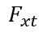
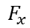
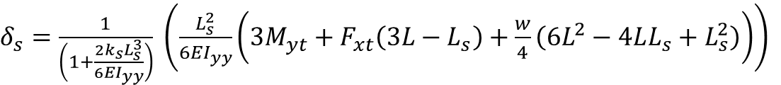
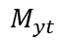
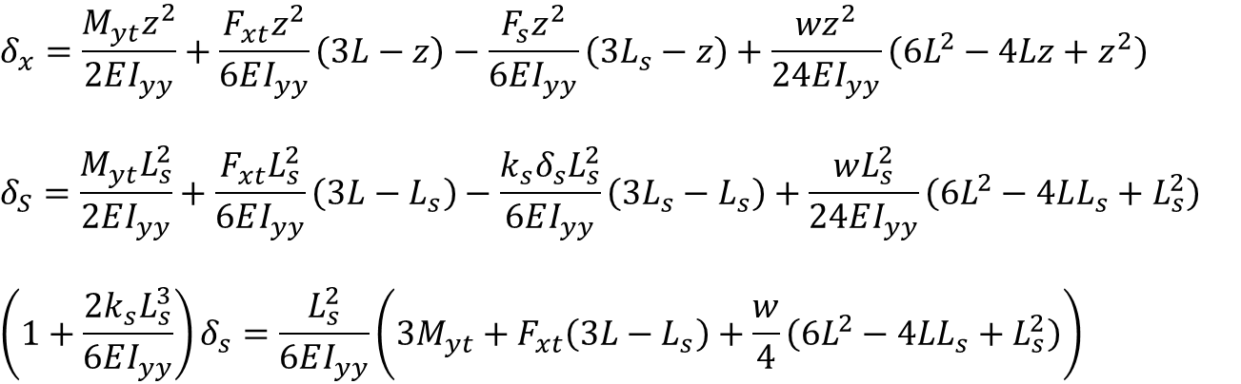
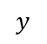
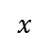
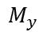
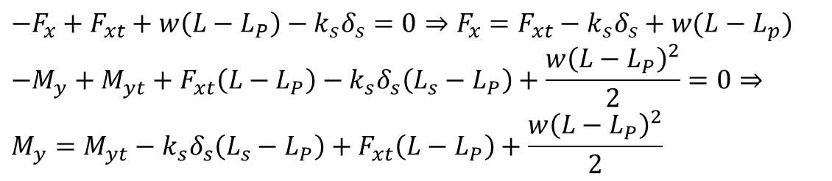
$$x$$
$$y$$
$$z$$
$$F_{s}=k_{s}δ_{s}$$
$$L_{P}$$
$$δ_{x}=\frac{M_{yt}z^{2}}{2EI_{yy}}+\frac{F_{xt}z^{2}}{6EI_{yy}}\left(3L−z\right)−\frac{F_{s}z^{2}}{6EI_{yy}}\left(3L_{s}−z\right)+\frac{wz^{2}}{24EI_{yy}}\left(6L^{2}−4Lz+z^{2}\right)$$
$$δ_{S}=\frac{M_{yt}L_{s}^{2}}{2EI_{yy}}+\frac{F_{xt}L_{s}^{2}}{6EI_{yy}}\left(3L−L_{s}\right)−\frac{k_{s}δ_{s}L_{s}^{2}}{6EI_{yy}}\left(3L_{s}−L_{s}\right)+\frac{wL_{s}^{2}}{24EI_{yy}}\left(6L^{2}−4LL_{s}+L_{s}^{2}\right)$$
$$\left(1+\frac{2k_{s}L_{s}^{3}}{6EI_{yy}}\right)δ_{s}=\frac{L_{s}^{2}}{6EI_{yy}}\left(3M_{yt}+F_{xt}\left(3L−L_{s}\right)+\frac{w}{4}\left(6L^{2}−4LL_{s}+L_{s}^{2}\right)\right)$$
$$P$$
$$s$$
$$M_{yt}$$
$$w$$
$$F_{xt}$$
$$L_{s}$$
$$L$$
$$F_{x}$$
$$F_{s}=k_{s}δ_{s}$$
$$M_{y}$$
$$P$$
$$s$$
$$M_{yt}$$
$$w$$
$$F_{xt}$$
$$L_{s}−L_{P}$$
$$L−L_{P}$$
$δ_{s}=\frac{1}{\left(1+\frac{2k_{s}L_{s}^{3}}{6EI_{yy}}\right)} \left(\frac{L_{s}^{2}}{6EI_{yy}}\left(3M_{yt}+F_{xt}\left(3L−L_{s}\right)+\frac{w}{4}\left(6L^{2}−4LL_{s}+L_{s}^{2}\right)\right)\right)$
$$−F_{x}+F_{xt}+w\left(L−L_{P}\right)−k_{s}δ_{s}=0⇒F_{x}={F_{xt}−k}_{s}δ_{s}+w(L−L_{p})$$
$$−M_{y}+M_{yt}+F_{xt}\left(L−L_{P}\right)−k_{s}δ_{s}\left(L_{s}−L_{P}\right)+\frac{w{\left(L−L_{P}\right)}^{2}}{2}=0⇒ \\ M_{y}=M_{yt}−k_{s}δ_{s}\left(L_{s}−L_{P}\right)+F_{xt}\left(L−L_{P}\right)+\frac{w{\left(L−L_{P}\right)}^{2}}{2}$$

Slide 6
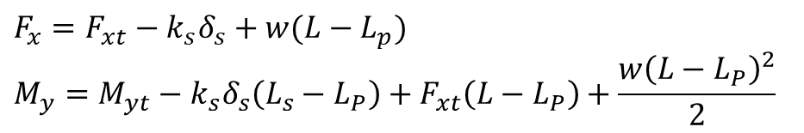
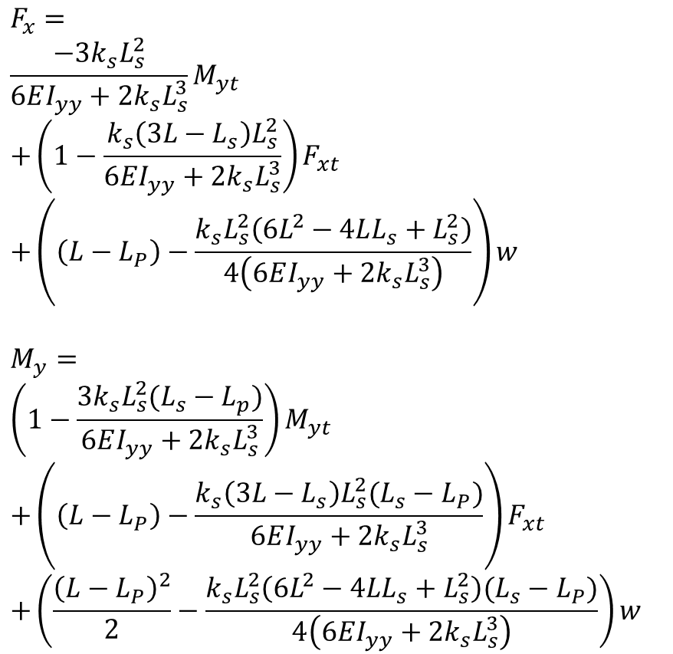
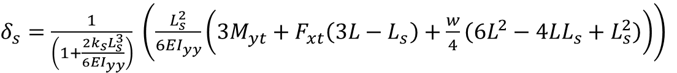
$$x$$
$δ_{s}=\frac{1}{\left(1+\frac{2k_{s}L_{s}^{3}}{6EI_{yy}}\right)} \left(\frac{L_{s}^{2}}{6EI_{yy}}\left(3M_{yt}+F_{xt}\left(3L−L_{s}\right)+\frac{w}{4}\left(6L^{2}−4LL_{s}+L_{s}^{2}\right)\right)\right)$
$$y$$
$$z$$
$$F_{s}=k_{s}δ_{s}$$
$$L_{P}$$
$$P$$
$$s$$
$$M_{yt}$$
$$w$$
$$F_{xt}$$
$$F_{x}={F_{xt}−k}_{s}δ_{s}+w(L−L_{p})$$
$$M_{y}=M_{yt}−k_{s}δ_{s}\left(L_{s}−L_{P}\right)+F_{xt}\left(L−L_{P}\right)+\frac{w{\left(L−L_{P}\right)}^{2}}{2}$$
$$L_{s}$$
$$L$$
$$F_{x}$$
$$F_{s}=k_{s}δ_{s}$$
$$F_{x}= \\ \frac{−3k_{s}L_{s}^{2}}{6EI_{yy}+2k_{s}L_{s}^{3}}M_{yt} \\ +\left(1−\frac{k_{s}\left(3L−L_{s}\right)L_{s}^{2}}{6EI_{yy}+2k_{s}L_{s}^{3}}\right)F_{xt} \\ +\left(\left(L−L_{P}\right)−\frac{k_{s}L_{s}^{2}\left(6L^{2}−4LL_{s}+L_{s}^{2}\right)}{4\left(6EI_{yy}+2k_{s}L_{s}^{3}\right)}\right)w$$
$$M_{y}= \\ \left(1−\frac{3k_{s}L_{s}^{2}(L_{s}−L_{p})}{6EI_{yy}+2k_{s}L_{s}^{3}}\right)M_{yt} \\ +\left(\left(L−L_{P}\right)−\frac{k_{s}\left(3L−L_{s}\right)L_{s}^{2}(L_{s}−L_{P})}{6EI_{yy}+2k_{s}L_{s}^{3}}\right)F_{xt} \\ +\left(\frac{{\left(L−L_{P}\right)}^{2}}{2}−\frac{k_{s}L_{s}^{2}\left(6L^{2}−4LL_{s}+L_{s}^{2}\right)(L_{s}−L_{P})}{4\left(6EI_{yy}+2k_{s}L_{s}^{3}\right)}\right)w$$
$$M_{y}$$
$$P$$
$$s$$
$$M_{yt}$$
$$w$$
$$F_{xt}$$
$$L_{s}−L_{P}$$
$$L−L_{P}$$

Slide 7
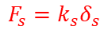
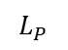
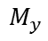





















$$y$$
$$x$$
$$x$$
$$z$$
$$F_{s}=k_{s}δ_{s}$$
$$y$$
$$z$$
$$F_{s}=k_{s}δ_{s}$$
$$L_{P}$$
$$L_{P}$$
$$P$$
$$s$$
$$M_{xt}$$
$$P$$
$$s$$
$$M_{yt}$$
$$w$$
$$F_{yt}$$
$$w$$
$$F_{xt}$$
$$L_{s}$$
$$L_{s}$$
$$L$$
$$L$$
$$F_{y}$$
$$F_{s}=k_{s}δ_{s}$$
$$F_{x}$$
$$F_{s}=k_{s}δ_{s}$$
$$M_{x}$$
$$P$$
$$s$$
$$M_{xt}$$
$$M_{y}$$
$$P$$
$$s$$
$$M_{yt}$$
$$w$$
$$F_{yt}$$
$$w$$
$$F_{xt}$$
$$L_{s}−L_{P}$$
$$L_{s}−L_{P}$$
$$L−L_{P}$$
$$L−L_{P}$$
$$F_{x}= \underset{F_{15}(L_{s})}{\underbrace{\frac{−3k_{s}L_{s}^{2}}{6EI_{yy}+2k_{s}L_{s}^{3}}}}M_{yt}+\underset{F_{11}\left(L_{s}\right)}{\underbrace{\left(1−\frac{k_{s}\left(3L−L_{s}\right)L_{s}^{2}}{6EI_{yy}+2k_{s}L_{s}^{3}}\right)}}F_{xt}+\left(\left(L−L_{P}\right)−\frac{k_{s}L_{s}^{2}\left(6L^{2}−4LL_{s}+L_{s}^{2}\right)}{4\left(6EI_{yy}+2k_{s}L_{s}^{3}\right)}\right)w$$
$$M_{y}= \underset{F_{55}(L_{s})}{\underbrace{\left(1−\frac{3k_{s}L_{s}^{2}(L_{s}−L_{p})}{6EI_{yy}+2k_{s}L_{s}^{3}}\right)}}M_{yt}+\underset{F_{51}\left(L_{s}\right)}{\underbrace{\left(\left(L−L_{P}\right)−\frac{k_{s}\left(3L−L_{s}\right)L_{s}^{2}(L_{s}−L_{P})}{6EI_{yy}+2k_{s}L_{s}^{3}}\right)}}F_{xt}+\left(\frac{{\left(L−L_{P}\right)}^{2}}{2}−\frac{k_{s}L_{s}^{2}\left(6L^{2}−4LL_{s}+L_{s}^{2}\right)(L_{s}−L_{P})}{4\left(6EI_{yy}+2k_{s}L_{s}^{3}\right)}\right)w$$
$$F_{y}=\underset{F_{24}}{\underbrace{\frac{3k_{s}L_{s}^{2}}{6EI_{xx}+2k_{s}L_{s}^{3}}}}M_{xt}+\underset{F_{22}}{\underbrace{\left(1−\frac{k_{s}\left(3L−L_{s}\right)L_{s}^{2}}{6EI_{xx}+2k_{s}L_{s}^{3}}\right)}}F_{yt}+\left(\left(L−L_{P}\right)−\frac{k_{s}L_{s}^{2}\left(6L^{2}−4LL_{s}+L_{s}^{2}\right)}{4\left(6EI_{xx}+2k_{s}L_{s}^{3}\right)}\right)w$$
$$M_{x}= \underset{F_{44}}{\underbrace{\left(1−\frac{3k_{s}L_{s}^{2}(L_{s}−L_{p})}{6EI_{xx}+2k_{s}L_{s}^{3}}\right)}}M_{xt}+\underset{F_{42}}{\underbrace{\left(\frac{k_{s}\left(3L−L_{s}\right)L_{s}^{2}(L_{s}−L_{P})}{6EI_{xx}+2k_{s}L_{s}^{3}}−\left(L−L_{P}\right)\right)}}F_{yt}+\left(\frac{k_{s}L_{s}^{2}\left(6L^{2}−4LL_{s}+L_{s}^{2}\right)(L_{s}−L_{P})}{4\left(6EI_{xx}+2k_{s}L_{s}^{3}\right)}−\frac{{\left(L−L_{P}\right)}^{2}}{2}\right)w$$

Slide 8

$$L_{s}=L_{sO}−P$$
L_s + p =
Pmin <P < pmax
-pmax<-P < -pmin
L

Slide 9


$$A\left[\begin{aligned}N_{n1} \\ N_{n2} \\ N_{n3} \\ N_{n4} \\ N_{n5} \\ N_{n6}\end{aligned}\right]=\left[\begin{aligned}F_{x} \\ F_{y} \\ F_{z} \\ M_{x} \\ M_{y} \\ M_{z}\end{aligned}\right]=\left[\begin{matrix}F_{11}\left(L_{s}\right) & 0 & 0 & 0 & F_{15}\left(Ls\right) & 0 \\ 0 & F_{22}\left(L_{s}\right) & 0 & F_{24}\left(L_{s}\right) & 0 & 0 \\ 0 & 0 & 1 & 0 & 0 & 0 \\ 0 & F_{42}\left(L_{s}\right) & 0 & F_{44}\left(L_{s}\right) & 0 & 0 \\ F_{51}\left(L_{s}\right) & 0 & 0 & 0 & F_{55}\left(L_{s}\right) & 0 \\ 0 & 0 & 0 & 0 & 0 & 1\end{matrix}\right]\left[\begin{aligned}\begin{aligned}F_{xt} \\ F_{yt} \\ F_{zt} \\ M_{xt} \\ M_{yt} \\ M_{zt}\end{aligned}\end{aligned}\right]$$
Input force profile loaded from the
ATI force sensor readings of the force
sensor calibration in TRO paper
The calibration matrix calculated in the
TRO paper when the sensor is mounted on a steel shaft

Slide 10




$$\left[\begin{aligned}\begin{aligned}F_{xt} \\ F_{yt} \\ F_{zt} \\ M_{xt} \\ M_{yt} \\ M_{zt}\end{aligned}\end{aligned}\right]$$
$$\left[\begin{aligned}N_{n1} \\ N_{n2} \\ N_{n3} \\ N_{n4} \\ N_{n5} \\ N_{n6}\end{aligned}\right]$$

Slide 11









$$F_{11}=1−\frac{k_{s}\left(3L−L_{s}\right)L_{s}^{2}}{6EI_{yy}+2k_{s}L_{s}^{3}}=1−\left(3L−L_{s}\right)g\left(c_{y},L_{s}\right)$$
$$\left[\begin{aligned}N_{n1} \\ N_{n2} \\ N_{n3} \\ N_{n4} \\ N_{n5} \\ N_{n6}\end{aligned}\right]=A^{−1 }\underset{H}{\underbrace{\left[\begin{matrix}F_{11} & 0 & 0 & 0 & F_{15} & 0 \\ 0 & F_{22} & 0 & F_{24} & 0 & 0 \\ 0 & 0 & 1 & 0 & 0 & 0 \\ 0 & F_{42} & 0 & F_{44} & 0 & 0 \\ F_{51} & 0 & 0 & 0 & F_{55} & 0 \\ 0 & 0 & 0 & 0 & 0 & 1\end{matrix}\right]}}\left[\begin{aligned}\begin{aligned}F_{xt} \\ F_{yt} \\ F_{zt} \\ M_{xt} \\ M_{yt} \\ M_{zt}\end{aligned}\end{aligned}\right]$$
$$F_{15}= \frac{−3k_{s}L_{s}^{2}}{6EI_{yy}+2k_{s}L_{s}^{3}}=−3g\left(c_{y},L_{s}\right)$$
$$F_{22}=1−\frac{k_{s}\left(3L−L_{s}\right)L_{s}^{2}}{6EI_{xx}+2k_{s}L_{s}^{3}}=1−\left(3L−L_{s}\right)g(c_{x},L_{s})$$
$$F_{24}=\frac{3k_{s}L_{s}^{2}}{6EI_{xx}+2k_{s}L_{s}^{3}}=3g\left(c_{x},L_{s}\right)$$
$$L_{s}=L_{s,OS}+q_{5}$$
$$F_{42}=\frac{k_{s}\left(3L−L_{s}\right)L_{s}^{2}(L_{s}−L_{P})}{6EI_{xx}+2k_{s}L_{s}^{3}}−\left(L−L_{P}\right)=\left(3L−L_{s}\right)\left(L_{s}−L_{P}\right)g\left(c_{x},L_{s}\right)−\left(L−L_{P}\right)$$
$$F_{44}=1−\frac{3k_{s}L_{s}^{2}\left(L_{s}−L_{p}\right)}{6EI_{xx}+2k_{s}L_{s}^{3}}=1−3\left(L_{s}−L_{P}\right)g\left(c_{x},L_{s}\right)$$
$$F_{51}=\left(L−L_{P}\right)−\frac{k_{s}\left(3L−L_{s}\right)L_{s}^{2}\left(L_{s}−L_{P}\right)}{6EI_{yy}+2k_{s}L_{s}^{3}}=\left(L−L_{P}\right)−\left(3L−L_{s}\right)\left(L_{s}−L_{P}\right)g\left(c_{y},L_{s}\right)$$
$$F_{55}=1−\frac{3k_{s}L_{s}^{2}\left(L_{s}−L_{p}\right)}{6EI_{yy}+2k_{s}L_{s}^{3}}=1−3\left(L_{s}−L_{P}\right)g\left(c_{y},L_{s}\right)$$

Slide 12



Total Parameters: 41
6x6 parameters in matrix $A$
length of the shaft $L$
Lumped shaft parameter: $c_{x},c_{y}$
Location of the cross-section: $L_{P}$
Encoder offset for instrument insertion: $L_{s},os$
Cost function: $Σ_{i=1}^{N}{\left\|AN_{ni}−H_{i}\left(c,L,L_{s,os}\right)F_{ti}\right\|}_{2}^{2}$
The optimization problem is not convex because there is a calibration matrix A for any arbitrarily selected $L_{P}$
So we arbitrarily select $L_{P}$ and we end up with 40 parameters
Implement coordinate optimization and projected gradient method with the constraints below:
Select: $L_{P}<\min\left(L_{s}\right)$
$$0.1 c_{n}<c_{x}, c_{y}<10 c_{n} \\ \max\left(L_{s}\right)<L<1.5 L_{n}$$
Fix $c_{x}$ and $c_{y}$ to an initial value, solve for $A$, $L$, and $L_{s,os}$.
Then fix $A, L, L_{s,os}$and solve for $c_{x}$ and $c_{y}$
Iterate between 1 and 2

Slide 13


Slide 14


Slide 15


Slide 16





Fontanelli et al. 2017
For the case of the instrument used in the experiments, the dynamic effects (gravity and inertial forces) are small compared to the range of the measured forces (about 1% of the maximum force) and could be neglected. Of course, when instruments with higher weight and inertia are used, the dynamic effects should be compensated.
Schwalb et al. 2017
During MIS, inertia is low and is assumed to be negligible, and is further validated in the experimental results section.
$$\left[\begin{aligned}F_{x} \\ F_{y} \\ F_{z} \\ M_{x} \\ M_{y} \\ M_{z}\end{aligned}\right]=\left[\begin{matrix}F_{11}\left(L_{s}\right) & 0 & 0 & 0 & F_{15}\left(Ls\right) & 0 \\ 0 & F_{22}\left(L_{s}\right) & 0 & F_{24}\left(L_{s}\right) & 0 & 0 \\ 0 & 0 & 1 & 0 & 0 & 0 \\ 0 & F_{42}\left(L_{s}\right) & 0 & F_{44}\left(L_{s}\right) & 0 & 0 \\ F_{51}\left(L_{s}\right) & 0 & 0 & 0 & F_{55}\left(L_{s}\right) & 0 \\ 0 & 0 & 0 & 0 & 0 & 1\end{matrix}\right]\left[\begin{aligned}\begin{aligned}F_{xt} \\ F_{yt} \\ F_{zt} \\ M_{xt} \\ M_{yt} \\ M_{zt}\end{aligned}\end{aligned}\right]$$
Assuming $I_{xx} = I_{yy}$
$$F_{11}=F_{22}, F_{15}=−F_{24},F_{42}=−F_{51},F_{44}=F_{55}$$
Assuming $M_{xt} = 0$and $M_{yt}$= 0
We do not need to identify: $F_{15},F_{24},F_{44},F_{55}$
$$\left[\begin{aligned}F_{x} \\ F_{y} \\ F_{z} \\ M_{x} \\ M_{y} \\ M_{z}\end{aligned}\right]=\left[\begin{matrix}F_{11}\left(L_{s}\right) & 0 & 0 & 0 \\ 0 & F_{11}\left(L_{s}\right) & 0 & 0 \\ 0 & 0 & 1 & 0 \\ 0 & F_{42}\left(L_{s}\right) & 0 & 0 \\ {−F}_{42}\left(L_{s}\right) & 0 & 0 & 0 \\ 0 & 0 & 0 & 1\end{matrix}\right]\left[\begin{aligned}\begin{aligned}F_{xt} \\ F_{yt} \\ F_{zt} \\ M_{zt}\end{aligned}\end{aligned}\right]$$
We only need to identify two functions, $F_{11}$ and $F_{42}$
$$F_{11}=1−\frac{L_{s}^{2}\left(3L−L_{s}\right)}{c+2L_{s}^{3}}$$
$$F_{42}= \frac{L_{s}^{2}\left(3L−L_{s}\right)(L_{s}−L_{P})}{c+2L_{s}^{3}}−\left(L−L_{P}\right)$$

Slide 17



Slide 18













$$y$$
$$B$$
$$x$$
$$z$$
$$H$$
$$\vec{e_{1}}$$
$$\vec{l_{1}}$$
$$d_{z}$$
$$H′$$
$$C$$
$$r_{s}$$
$$P$$

Slide 20









$$\vec{e_{2}}$$
$$y$$
$$\vec{e_{3}}$$
$$\vec{e_{1}}$$
$$x$$
$$\vec{e_{4}}$$
$$r_{s}$$
$$\vec{e_{6}}$$
$$\vec{e_{5}}$$

Slide 21

Interconnect Flex
Bicell Board
Adjustment Gear
Infrared LED
Bicell Photodiode
Onboard ADC

Slide 22


Slide 23
Model-based Calibration

Slide 24



Slide 25


Slide 26
Neural Network Calibration

Slide 27


Elapsed time is 0.001796 seconds.
45 minutes training

Slide 28




Slide 29


Elapsed time is 0.001754 seconds.
45 minutes training

Slide 30




